Slide 1
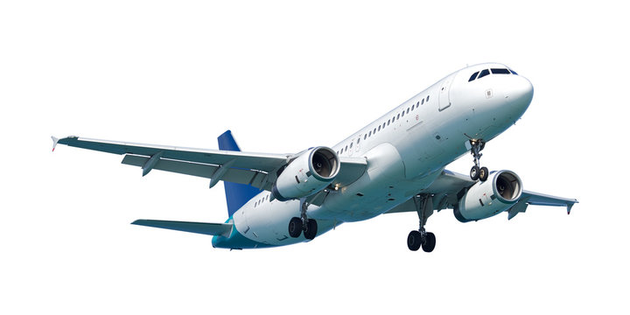
Market Analysis and Strategic Recommendations for New Airline Entry in Mumbai
Pranali Chavan
Data Analyst

Slide 2


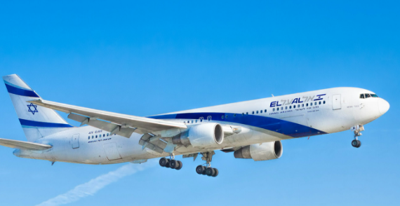
Mumbai Airline Service KPI Dashboard
Total Passengers
AVG Market Share
No. of Airline
95 Million
20%
5 Airlines

Slide 3

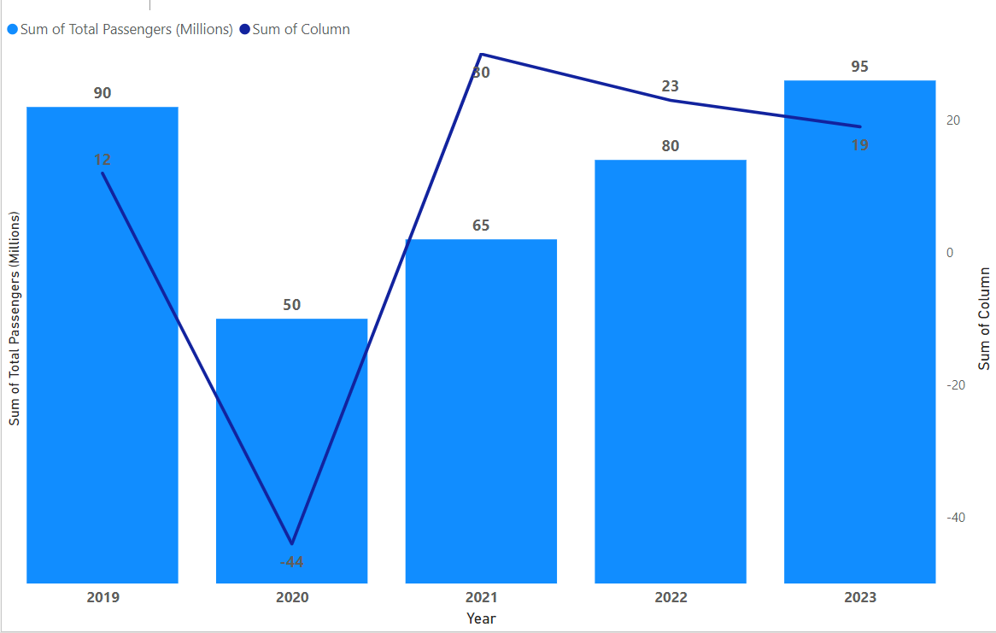



Market size for Airline Industry
Strong Recovery: After the significant drop in 2020, the industry showed a strong recovery in 2021 and 2022.
Post-Pandemic Growth: By 2023, the total passenger count had not only recovered but exceeded 2019 levels.
Declining Growth Rates: While the total number of passengers is increasing, the growth rate has been slowing down after the initial post-COVID surge, signaling a normalization of the market.

Slide 4
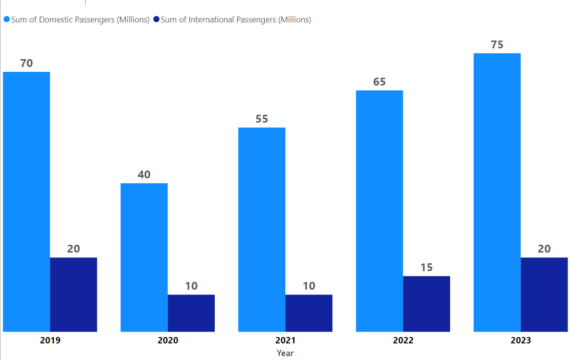
Domestic vs. International Traffic
Analysis of total, domestic and international passenger data from 2019 to 2023.
Domestic: Typically accounts for around 70-75% of the total traffic.
In 2023: Estimated around 75 million domestic passengers.
International: Accounts for the remaining 20-25%.
In 2023: Estimated around 20 million international passengers.

Slide 5
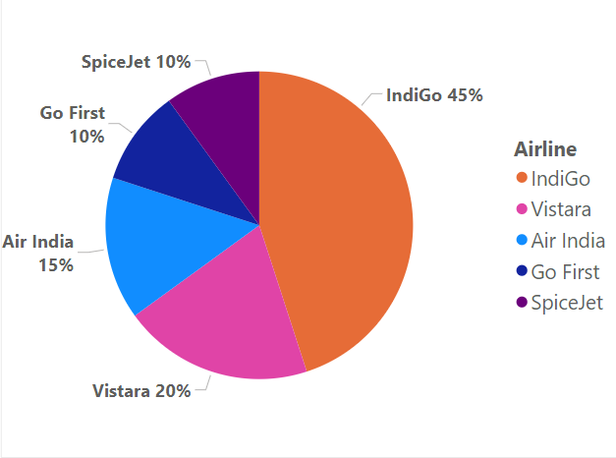
Airline Market share
The Mumbai market is highly competitive, with IndiGo clearly leading, followed by Vistara. However, there is still room for growth by offering differentiated services and targeting price-sensitive segments.
The new airline can carve a niche by providing affordable and flexible services, catering to the growing demand for domestic leisure travel and expanding regional routes under schemes like UDAN.

Slide 6




SWOT Analysis for New Low-Cost Airline Entry into Mumbai Market
Strengths
Weaknesses
Low-Cost Model
Untapped Regional Routes
Potential for Innovative Services
Operational Flexibility
Limited Economies of Scale
Lack of Brand Recognition
Initial Infrastructure Challenges
Limited International Reach

Slide 7



SWOT Analysis for New Low-Cost Airline Entry into Mumbai Market
Opportunities
Threats
Growth in Domestic Air Travel
Underserved Regional Routes
Leveraging Partnerships
Consumer Preference for Low-Cost Travel
Intense Competition
High Operational Costs
Regulatory and Infrastructure Barriers
Market Saturation

Slide 8
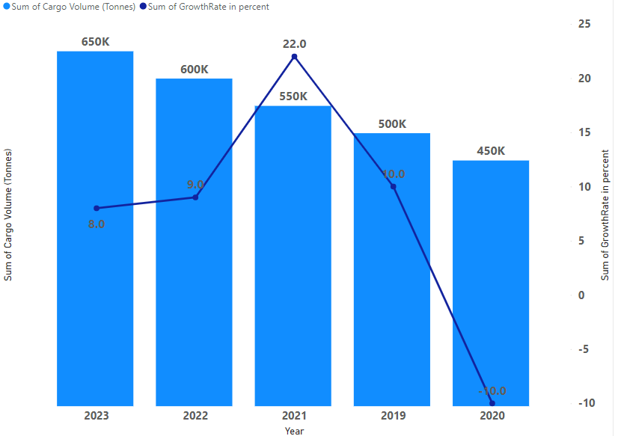
Cargo Traffic & Growth
2019: 500,000 tonnes of cargo (+10% growth).
2020: 450,000 tonnes (-10% decline due to COVID-19 impact)
2021: 550,000 tonnes (+22% growth, strong recovery)
2022: 600,000 tonnes (+9% growth)
2023: 650,000 tonnes (+8% growth)
Cargo traffic dipped during the pandemic but recovered significantly in 2021, driven by high demand for air freight and e-commerce shipments.

Slide 9
Market Segmentation Analysis
Business Travelers
Leisure Travelers
Cargo Customers
Business travelers generally prioritize convenience, flight frequency, and premium services.
This segment is highly concentrated on domestic routes between major cities (Mumbai-Delhi, Mumbai-Bangalore, etc.) as well as international financial hubs (Dubai, London, Singapore).
Approximate 60-70% of total passengers are Leisure Travelers.
This is the largest market segment, dominated by domestic tourism and international vacations
Popular Domestic Locations: Goa, Kerala, Rajasthan.
Popular International Locations: Dubai, Bangkok, Maldives
Based on cargo tonnage data for Mumbai Airport, cargo typically contributes a significant but smaller portion of airport operations. Around 500,000-650,000 tones of cargo were handled annually between 2019 and 2023.
E-commerce boom post-pandemic, leading to increased air cargo traffic.

Slide 10
Recommendations
The new airline can achieve success in the Mumbai market by focusing on the low-cost leisure segment.
offering affordable international flights, catering to business travelers with flexible services,
Building a strong cargo operation targeting e-commerce.
Strategic use of government initiatives, technology-driven efficiencies
Competitive pricing will help them differentiate from existing players and capture a significant share of the market.

